Slide 1

Leveraging Data Tools for Sales and Cost Optimization at Adventure Works Cycles
Presented By:
Group 4
Team Members:
Angara Rishabh
Divya V
Nisha R
Rohan Hemant Ahire
Varun S
Vijesh Prahlad Yadav

Slide 2
Overview of Contents
Company Insights and Key Challenges
Key Performance Indicators (KPIs) & Insights
Excel Dashboards
Tableau Dashboard
Power BI Dashboard
SQL Queries Output
Project Summary
Key Learnings

Slide 3

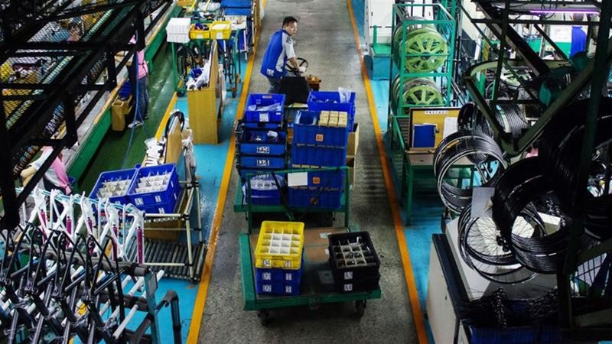
Adventure Works Cycles: Company Insights and Key Challenges
Company Overview:
Adventure Works Cycles is a multinational bicycle manufacturer.
Headquarters in Bothell, Washington, with 290 employees.
Manufacturing plant in Mexico for subcomponent production.
In 2001 Mexican plant became sole manufacturer and distributor
for the touring bicycle product group.
Key Challenges:
Adventure Works Cycles is facing the challenge of broadening its market share while maintaining operational efficiency. Specifically, the company is looking to
address the following issues:
TARGETING BEST CUSTOMERS
The company aims to identify and prioritize its top customers to enhance relationships and boost revenue.
EXPANDING PRODUCT ACCESS
Adventure Works plans to launch an external website to improve product accessibility and streamline customer interactions.
REDUCING PRODUCTION COSTS The company seeks to lower its production cost through more efficient manufacturing processes

Slide 4
Key Performance Indicators (KPIs) & Insights
Insights:
Total Sales also followed the same upward trend, with 2013 achieving the highest revenue at 16.35M. The Bikes category contributed the most to sales, with Road Bikes and Mountain Bikes being top performers.
Total Orders saw a significant increase, especially in 2013, where 52,801 orders were received compared to 2,216 in 2011. This surge in orders was driven by the company’s expansion into Accessories and Clothing categories starting in 2012.
From Dec 2010 to Jan 2014, the company received 60,398 total orders, generating 29.36M in sales. The total production cost amounted to 17.28M, with the company maintaining gross profit margin 41.15% and net profit margin 30.65%.
Production Costs increased over the years, but the company maintained consistent gross profit margins (around 40-41.56%). Bikes accounted for the highest production costs, particularly Road Bikes and Mountain Bikes. Despite the rise in production costs, the company’s ability to manage costs effectively helped sustain profitability, with strong margins seen particularly in North America (41.62%).

Slide 5
Key Performance Indicators (KPIs) & Insights

Slide 6
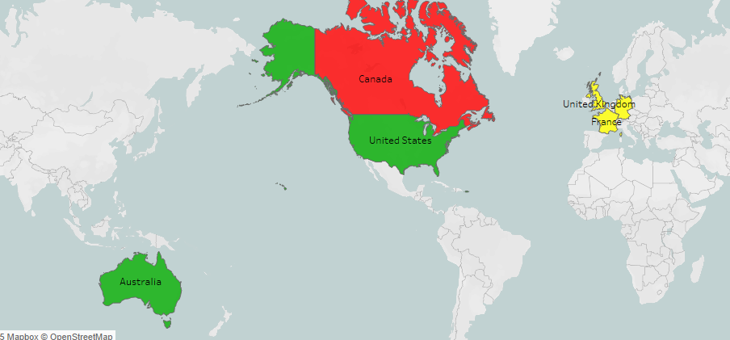
Key Performance Indicators (KPIs) & Insights
a) Regional Performance Analysis
North America, particularly the United States, was the largest contributor to both orders and sales. Within North America, the Southwest and Northwest regions of the U.S. recorded the highest volumes.
Following North America, Australia, part of the Pacific region, made the second-highest sales.
Europe came next, with the United Kingdom leading in sales, although overall sales in Europe were lower than in North America and Australia.
Among all the countries, Canada had the lowest sales.

Slide 7
Key Performance Indicators (KPIs) & Insights
b) Product Category Performance:
Bikes remained the dominant category for both orders and sales, particularly in the Road Bikes and Mountain Bikes subcategories.
Accessories and Clothing also made significant contributions starting in 2012, with key subcategories such as helmets, tires, caps, and jerseys showing strong sales.
The company’s expansion into these categories helped broaden its customer base and reduce dependency on the Bikes category alone.

Slide 8
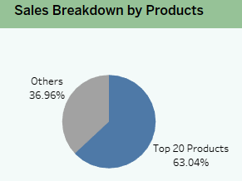
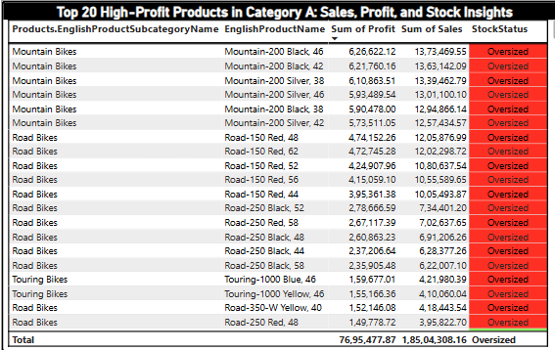
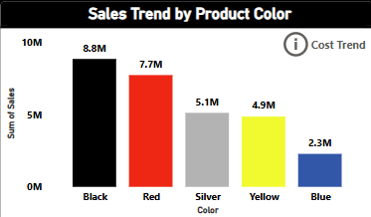
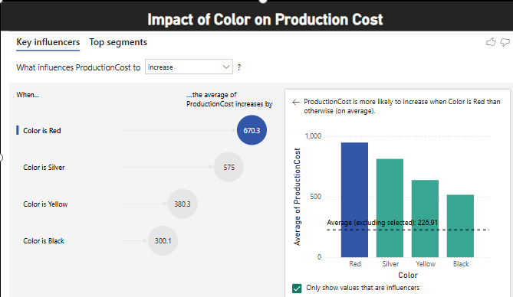
Key Performance Indicators (KPIs) & Insights
c) Product Sales and Cost Dynamics:
Top 20 Products: Account for 63.04% of company revenue, generating significant sales and profit.
Inventory Status: High-profit products are currently oversized.
Mountain-200 Black (46): Most profitable product in the company.
Color Insights: Among the top products, Red, Silver, Black, and Yellow are the most purchased colors.
Red & Silver: Have a high impact on production costs.
Red increases costs by 670.3 units
Silver increases costs by 575 units
Black: Despite high sales, has a low impact on production costs.

Slide 9
Key Performance Indicators (KPIs) & Insights
d) Customer Insights and Their Role in Performance:
The company has 18,484 customers, with 246 top-tier customers and 3,164 steady shoppers. These groups likely contribute to repeat orders and consistent sales growth, especially in the Bikes and Accessories categories.
Customers in professional occupations with medium incomes were the primary drivers of sales.
Furthermore, female customers outpaced male customers, and multiple car owners (despite purchasing less frequently) showed a strong preference for Mountain and Touring Bikes, indicating a niche market for premium, recreational products.

Slide 10
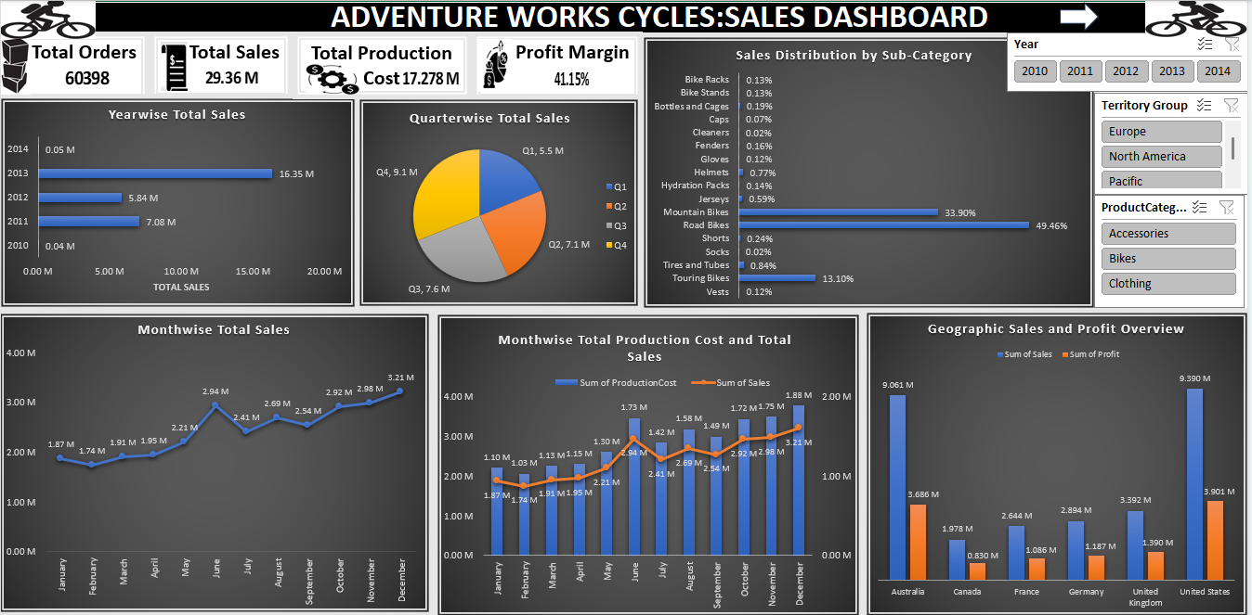
Excel Dashboards

Slide 11
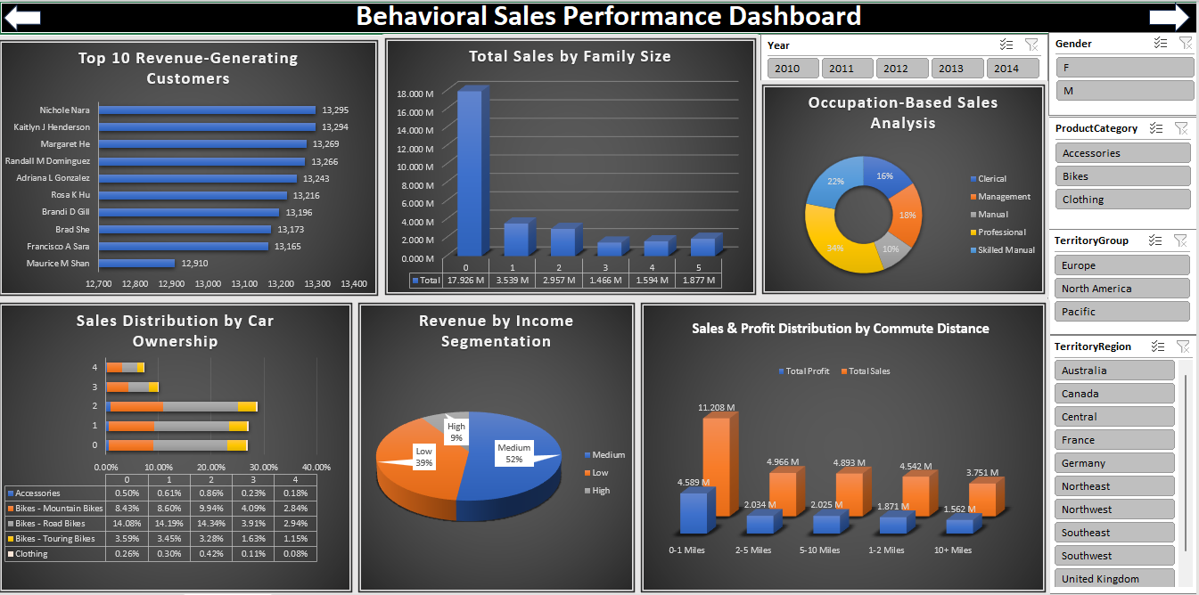
Excel Dashboards

Slide 12
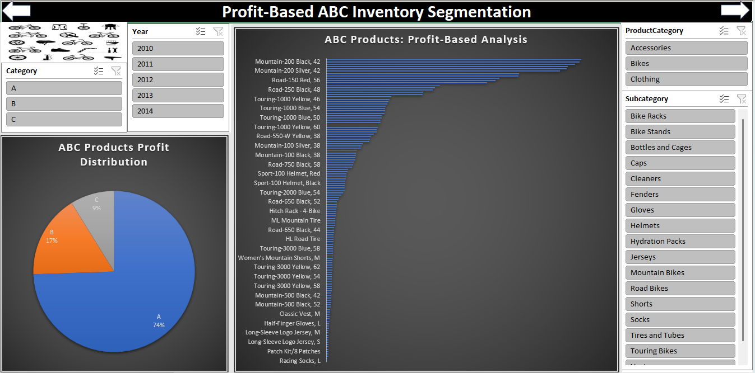
Excel Dashboards

Slide 13
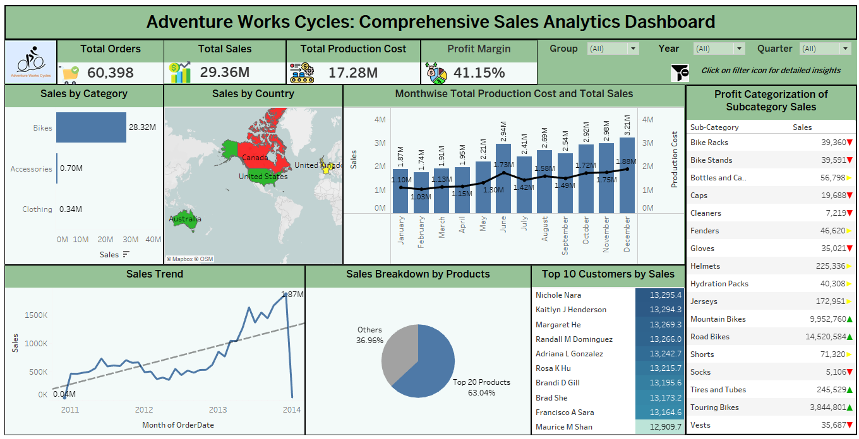
Tableau Dashboard

Slide 14
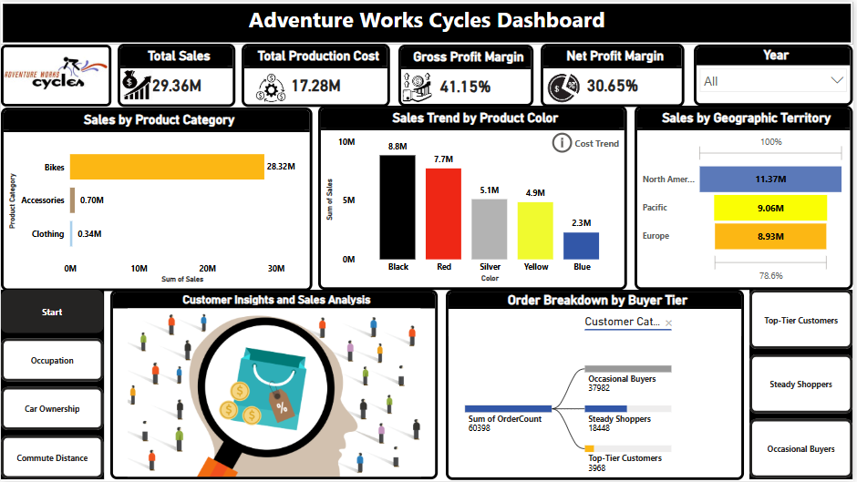
Power BI Dashboard

Slide 15
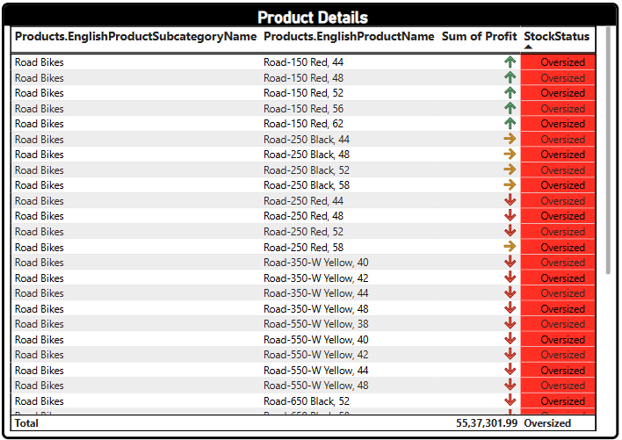
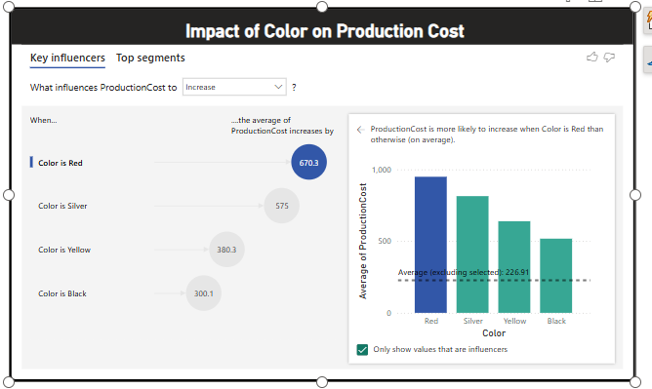
Power BI Dashboard

Slide 16
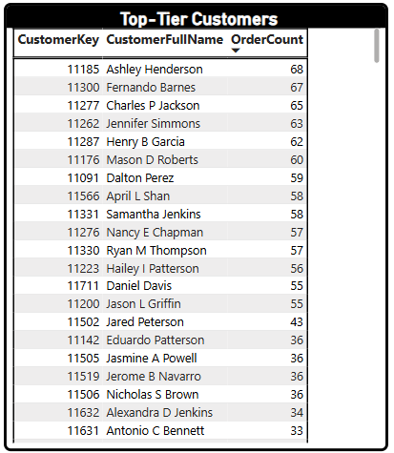
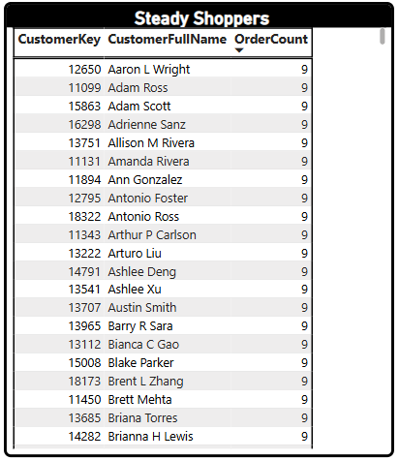
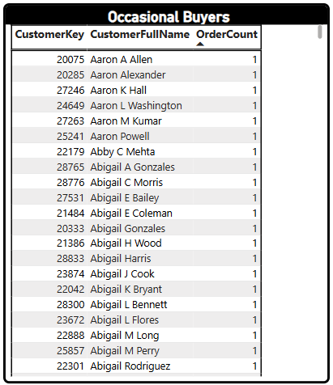
Power BI Dashboard

Slide 17
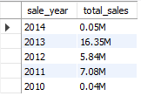
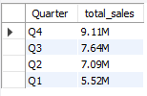

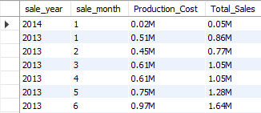
SQL Queries Output
Q1) Yearwise and Quarterwise Total Sales:
Q2) Monthwise Total Production Cost and Total Sales:

Slide 18
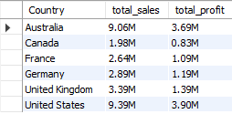

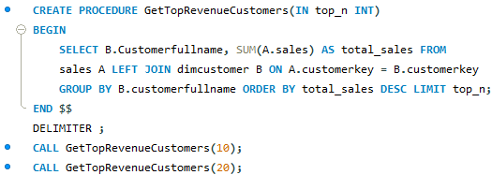
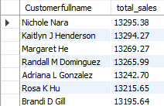
SQL Queries Output
Q3) Geographic Sales and Profit Overview:
Q4) Total Sales by Product Category:
Q5) Top Revenue Generating Customers:

Slide 19
Project Summary
The company’s growth in orders, sales, and profitability from 2011 to 2013 demonstrates strong demand for its products, particularly in the Bikes category.
Expanding into Accessories and Clothing categories has allowed the company to diversify its offerings and reduce dependency on a single category, broadening its market reach.
Sales were highest in the U.S., followed by Australia and the UK, driven mainly by medium-income professional customers with bachelor’s degrees, especially those with 1-2 cars traveling for short commutes.
Recommendations:
Sales Strategy
The company should focus on top-tier customers to drive more sales and communicate with them for special offers.
Multiple car owners represent a niche market for premium products like Mountain and Touring Bikes. Targeted campaigns highlighting outdoor biking lifestyles could boost sales in this segment.
Inventory Management
To avoid the storage and production cost burden, the company should focus on reducing inventory of oversized products in Product Category A. These items should not be manufactured further until the existing stock is sold out.
Production Cost Management
Market Focus
The company should seek cost-effective alternatives for red and silver materials to reduce production expenses and offset rising costs.
The company should focus on improving its market share in Canada and France, where sales are lower compared to other regions.

Slide 20
Key Learnings
Data Cleaning, Transformation, and Integration
Learned cleaning data by ensuring consistency, removing duplicates, and handling missing values.
Data Modeling
Explored data modeling across various platforms to determine the best fit for specific needs.
Statistical Segmentation and Insights
Gained skills in transforming data with conditional columns and standardizing formats, as well as merging and appending data from multiple sources to create a unified dataset
In Excel, organized data using tables and pivot tables for efficient analysis.
In Tableau and Power BI, built interactive dashboards to visualize the data.
Used SQL for querying databases, extracting data, and performing transformations before importing into visualization tools.
Building Visualizations and Dashboards
Developed interactive visualizations and dashboards to present data clearly.
Incorporated features like slicers, bookmarks, and navigators to enable users to drill down into specific data points for deeper insights.
Applied statistical methods to segment data, uncovering trends and patterns.
Derived actionable insights from the segmented data to inform better decision-making.

Slide 21
THANK YOU

